Slide 1
XML Schema

Slide 2
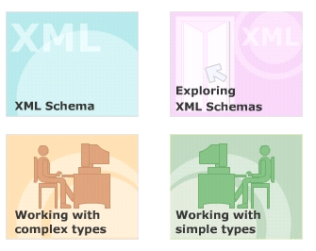
Module Introduction
Welcome to the module, XML Schema.
This module focuses on exploring XML schema and its features.
The structure of an XML document with the help of schema is also discussed.
This module aims at providing a clear understanding of the different elements and data types supported by an XML schema.
In this module, you will learn about:
  XML Schema
  Exploring XML Schemas
  Working with complex types
  Working with simple types

Slide 3
DTDs have some limitations.
DTDs are written in a non-XML syntax.
DTDs are not extensible.
They have no support for namespaces.
They only offer extremely limited data typing.

Slide 4
XML Schema
XML schema has been introduced, with an objective to overcome the drawbacks of DTDs.
The purpose of an XML Schema is to define the legal building blocks of an XML document, just like a DTD.
The XML Schema language is referred as XML Schema Definition (XSD).

Slide 5
Advantages of XML Schema over DTD
XML syntax is used as the basic for creating XML schema documents
XML schemas can be passed and manipulated just like any other XML document.
Riches data types
Archetypes
  Define own named data type from pre-existing data types
Attributes grouping
Refinable archetypes

Slide 6
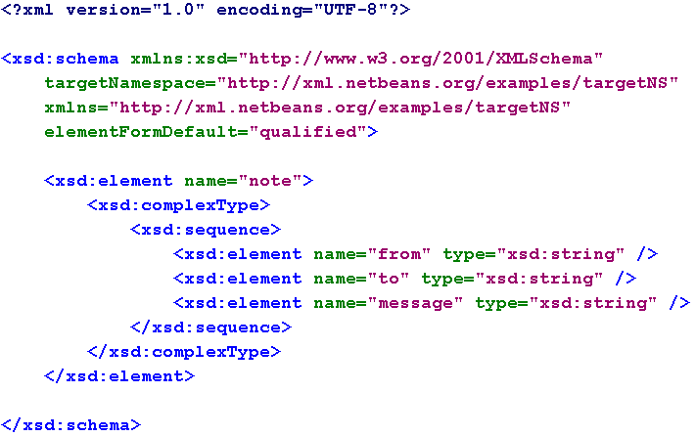
Example of XML Schema

Slide 7
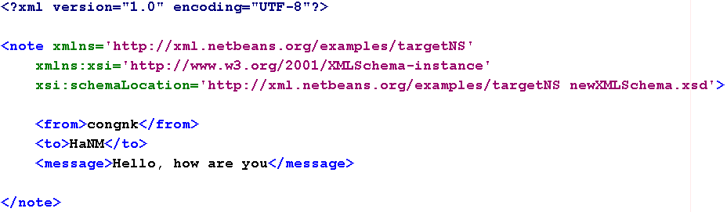
Referencing a Schema in an XML Document

Slide 8
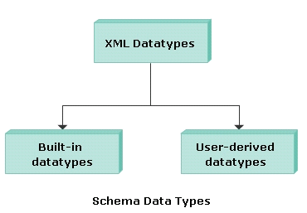
Data Types Supported by Schema
Data types use to specify and validate the intended data type of the content.
Built-in datatypes
User-derived datatypes

Slide 9
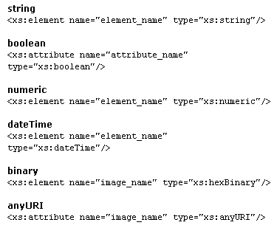
Built-in data types
string
boolean
numeric
dateTime
binary
anyURI

Slide 10
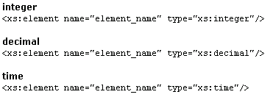
Generated or derived data types
Integer
decimal
time

Slide 11
Schema Vocabulary

Slide 12
Complex Types
A complex element is an XML element that contains other elements and/or attributes.
Four kinds
  Empty elements
  Only Elements
  Only Text
  Mixed

Slide 13
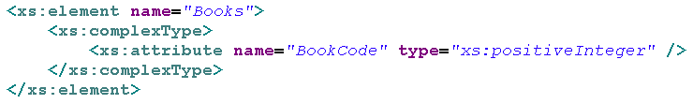
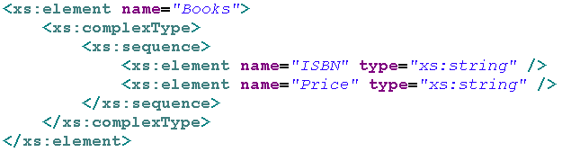
Complex Types
  Empty elements
  Only Elements

Slide 14
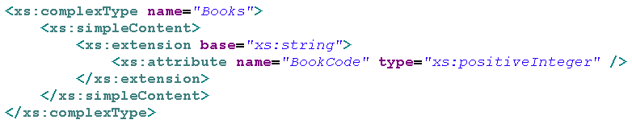
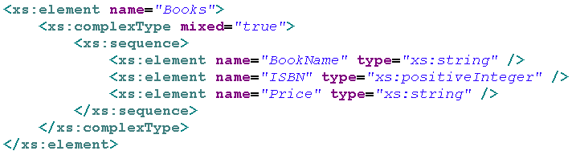
Complex Types
  Only Text
  Mixed

Slide 15
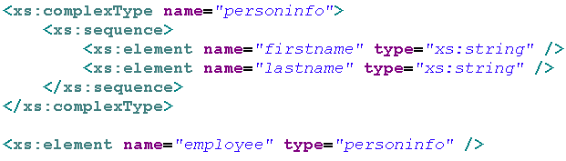
Define Complex Types
By directly naming the element
By using the name and type attribute of the complex type

Slide 16
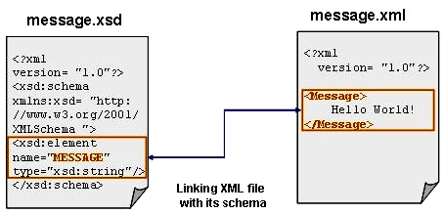
4.3- How to write an XML schema?

Slide 17
Grouping Constructs
Specify whether and how ordering of individual elements is important
Three grouping constructs.
xs:all
  Specifies that the child elements can appear in any order
  Each child element must occur only once:
xs:choice
  Specifies that either one child element or another can occur:
xs:sequence
  Specifies that the child elements must appear in a specific order:

Slide 18
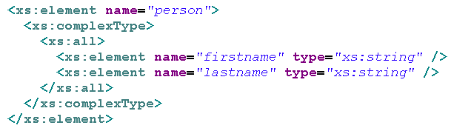
xs:all
Specifies that the child elements can appear in any order
Each child element must occur only once

Slide 19
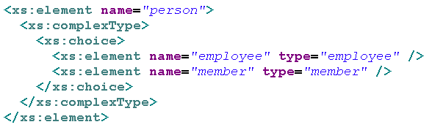
xs:choice
Specifies that either one child element or another can occur

Slide 20


Defining a Simple Type Element
A simple type is an XML element or attribute, which contains only text and no other elements or attributes.

Slide 21
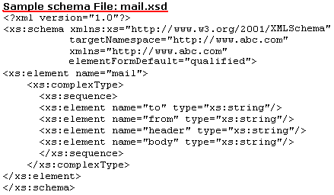
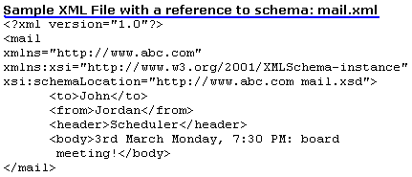
Demo

Slide 22
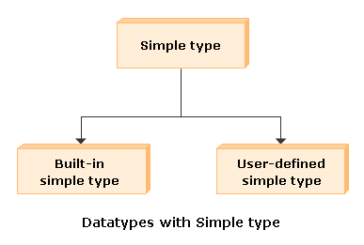
Data types used with simple types
built-in simple type
user-defined simple type

Slide 23
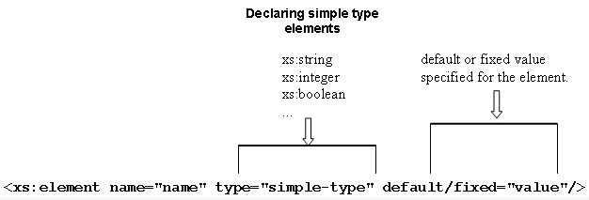
Built-in simple types
Can contain a default value or a fixed value.

Slide 24

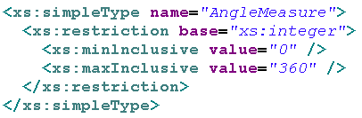
User-defined simple types
Create using the <simpleType> definition.
Syntax
Example

Slide 25
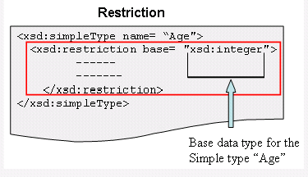
Restrictions
Declaration of a data type puts certain limitations on the content of an XML element or attribute.
To declare using the <restriction> declaration.

Slide 26
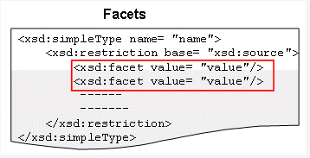
Restrictions
Restrictions on XML elements are called facets.
Facets are used to restrict the set or range of values a datatype can contain.
The value range defined by the facet must be equal to or narrower than the value range of the base type.
There are 12 facet elements

Slide 27
That’s about all for today!
XML Schema
Exploring XML Schemas
Working with complex types
Working with simple types
Thank you all for your attention and patient !

